Slide 1

DEPARTMENT OF ELECTRONICS & COMMUNICATION ENGINEERING
1156EC701-MAJOR PROJECT
SUMMER SEMESTER 2
REVIEW
“DESIGN AND DEVELOPEMENT OF E NOSE FOR FOOD QUALITY ANALYSIS”
SUPERVISED BY
Dr.E.D KANMANI RUBY
Proffesor
PRESENTED BY
1.K.V.SASI KIRAN REDDY (11572)(19UEEC0272)
2. Y.V.SRI CHARAN REDDY (11823)(19UEEC0630)
3. Y.MAHESHWARAREDDYY (11571)(19UEEC0645)

Slide 2
INTRODUCTION
An electronic nose (e-nose) is a device that uses sensors to mimic the human sense of smell in order to detect and identify various odors. E-noses have been developed for a variety of applications, including food quality analysis.
The design and development of an e-nose for food quality analysis involves selecting appropriate sensors, creating a sensor array, and developing algorithms for data analysis.
The goal is to create a device that can accurately and consistently detect and identify specific odors associated with food quality, such as spoiled or rancid odors.
The device can be used in food processing and storage facilities to monitor food quality and ensure that only safe, high-quality products are distributed to consumers.

Slide 3
LITERATURE REVIEW
Szadzinska, J,Lechtanska, J, Pashminehazar, R.; Kharaghani, A.; Tsotsas, 2019, E. Microwave- and ultrasound-assisted convective drying of raspberries: Drying kinetics and microstructural changes. Dry. Technol. 154,89-96.
Monitoring of pesticides in fruit and vegetable samples has increased in the last years since most countries have established maximum residue level (MRL) for pesticides in food products.
Despite the wide ranging benefits of using pesticides in agriculture, several incorrect applications can result in high and undesirable levels of the compounds in the produce that reaches consumers.
These include inappropriate selection of pesticides used on foodstuffs, over use of pesticides and harvesting the crops before the residues have washed off after application .

Slide 4
AGENDA
ABSTRACT
OBJECTIVE
INTRODUCTION
MOTIVATION
LITERATURE REVIEW
DESIGN AND METHODOLOGIES
IMPLEMENTATION
TABULATION

Slide 5
ABSTRACT
This study aims to design and develop an electronic nose (e-nose) for food quality analysis. The e-nose is a device that can detect and identify various volatile compounds in food samples, providing an objective and non-destructive method for evaluating food quality.
The design of the e-nose includes the selection of appropriate sensors, the development of a signal processing algorithm, and the integration of these components into a portable and user-friendly device.
The e-nose will be tested and validated using a variety of food samples to assess its ability to detect changes in food quality, such as spoilage or contamination.
The results of this study will provide a reliable and efficient tool for food quality analysis, with potential applications in the food industry, agriculture, and consumer products.

Slide 6
OBJECTIVES
To design an electronic nose (e-nose) system for testing the quality and ripeness of apples.
To accurately detect and identify volatile compounds in apples, which can indicate their quality and ripeness.
To minimize the cost of the e-nose system and make it widely available for use in the apple industry.

Slide 7
LITERATURE REVIEW
Arrutia, F. Adam, M. Calvo-Carrascal, M.A. Mao, Y. Binner, 2001, E. Development of a continuous-flow system for microwave- assisted extraction of pectin-derived oligosaccharides from food waste.
General Food Processing factors (PF) estimate the effect of processing methods pesticide on residue levels and the disposition of the residues in the processed products, calculated and considered by the joint FAO/WHO meeting on pesticide residues as follows PF = Residues in processed products mg Kg-1.
PF values lower than 1 indicate a reduction in the residue level and higher than 1, a concentration effect.
Foods 18 of 38 Friuts and Vegetables, like other foods, are treated through culinary and food processing before they are consumed.

Slide 8
DESIGN AND METHODOLOGIES
METHODOLOGY:
Selection and calibration of appropriate sensors: Selecting sensors that can detect a wide range of volatile compounds that are specific to apples and calibrating them for optimal performance.
Sample collection and preparation: Collecting apples from different stages of ripeness and preparing them for testing by removing any external contaminants.
Data acquisition and analysis: Acquiring data from the sensors and analyzing it to determine the quality and ripeness of the apples.
Validation of the e-nose system: Validating the e-nose system by comparing its results with those obtained from other testing methods.
Refining and improving the e-nose system: Continuously refining and improving the e-nose system based on the results of validation and user feedback.

Slide 9
ARCHITECTURE DIAGRAM
POWER SUPPLY
Sampling camber
DISPLAY AND COMMUNICATION SYSTEM
SENSORS
DATA ANALYSIS SOFTWARE

Slide 10

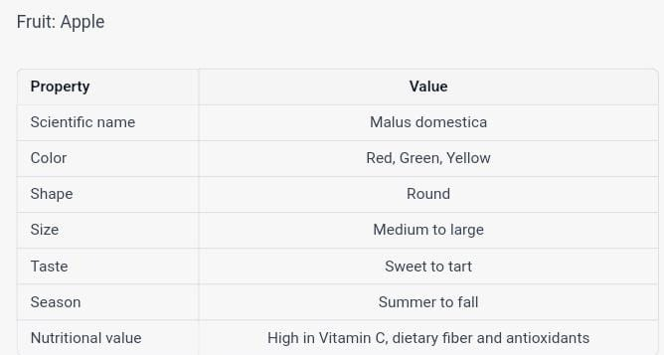
TABULATION
Figure 2

Slide 11
CONCLUSION
It is clear that the development of an eNose for food quality analysis has immense potential to revolutionize the food industry. By utilizing a combination of gas sensors, data processing, and artificial intelligence, the eNose can detect subtle changes in food quality and provide valuable insights into food safety and quality management. This technology can be used in a variety of applications, from early warning systems for food spoilage and contamination, to quality assurance for food producers. With further research and development, the eNose could become a key component of food quality management programs, helping to ensure that food is safe and of the highest quality for consumers.

Slide 12
REFERENCES
Arrutia, F.; Adam, M.; Calvo-Carrascal, M.Á.; Mao, Y.; Binner, E., 2001, Development of a continuous-flow system for microwave-assisted extraction of pectin-derived oligosaccharides from food waste. 352,182-186.
Szadzinska, J,Lechtanska, J, Pashminehazar, R.; Kharaghani, A.; Tsotsas, 2019, E. Microwave- and ultrasound-assisted convective drying of raspberries: Drying kinetics and microstructural changes. Dry. Technol. 154,89-96.
Belluzo M.S., Ribone M.E., Lagier C.M. Assembling Amperometric Biosensors for Clinical Diagnostics. Sensors. 2008;8:1366–1399.

Slide 13
SherlinVarughese, NayanaShinde, SwapnaliYadav, Jignesh Sisodia “Learning-Based Fruit Disease Detection Using Image Processing” International Journal of Innovative and Emerging Research in Engineering Volume 3, Issue 2, p-ISSN: 2394-5494,2016.
Mustapha F. A. Jallow, Dawood G. Awadh, Mohammed S. Albaho, Vimala Y. Devi, and NisarAhmad”Monitoring Of Pesticide Residue In Commonly Used Fruits And Vegetables In Kuwait”Int J Environ Res Public Health. 2017 Aug.
BhaviniJ.Samajpati, SheshangD.Degadwala “Hybrid Approach for Apple Fruit Diseases Detection and Classification Using Random Forest Classifier” IEEE International Conference on Communication and Signal Processing, pp. 978-5090-0396,2016.

